Slide 1
GLOBAL SUPPLY CHAIN
RISK ANALYSIS
EDA • Excel • Tableau • Power BI
Integrated Data Analytics & Business Intelligence Project

Slide 2
Presentation Overview
End-to-end workflow from raw data to interactive dashboards
01
01
Project Overview
Scope, objectives and analytical workflow
02
02
Dataset & EDA
Structure, quality checks, statistics and visual analysis
03
03
Excel Dashboard
KPI and operational reporting
04
04
Tableau Dashboard
Interactive visual exploration
05
05
Power BI Dashboard
KPI monitoring and business intelligence
06
06
Integrated Findings
Key observations, limitations and future scope

Slide 3
Project Objectives
Understand the structure and quality of global supply chain shipment data.
Explore shipment patterns across transport modes, product categories, weather and origin ports.
Study lead time in relation to distance, fuel price index, geopolitical risk and disruptions.
Examine carrier reliability and monthly shipment/disruption trends.
Transform EDA findings into practical Excel, Tableau and Power BI dashboards.
Present a consolidated analytical view for supply-chain monitoring and reporting.

Slide 4
Dataset Overview
Source: supplied EDA notebook
TOTAL RECORDS
5,000
COLUMNS
14
MISSING VALUES
0
DUPLICATES
0
5 product categories: Textiles, Automotive, Perishables, Electronics and Pharmaceuticals.
5 weather conditions: Clear, Fog, Hurricane, Rain and Storm.
9 origin ports are represented.
Transport modes: Air, Rail, Road and Sea.
Date is converted to datetime for monthly trend analysis.

Slide 5
Key Variables in the Dataset
Shipment_ID
Weight_MT
Date
Fuel_Price_Index
Origin_Port
Geopolitical_Risk_Score
Destination_Port
Weather_Condition
Transport_Mode
Carrier_Reliability_Score
Product_Category
Lead_Time_Days
Distance_km
Disruption_Occurred

Slide 6
Descriptive Statistics
Selected numeric measures from the supplied EDA
Distance
7,704.06 km
Weight
246.25 MT
Fuel Price Index
2.85
500.17 – 14,995.91
1.03 – 499.75
1.20 – 4.50
Geopolitical Risk
5.08
Carrier Reliability
0.754
Lead Time
19.36 days
0 – 10
0.50 – 1.00
0.50 – 236.39

Slide 7
Exploratory Data Analysis (EDA)
1
Import libraries: NumPy, Pandas, Matplotlib and Seaborn.
2
Inspect records, shape, data types and descriptive statistics.
3
Check missing values and duplicate rows.
4
Explore unique values, frequency counts and grouped categories.
5
Create distributions and category-based visualizations.
6
Analyze lead time against distance, fuel price and geopolitical risk.
7
Use correlation heatmap and monthly trend analysis.

Slide 8
EDA Visual Analysis
Shipments by Transport Mode
Shipments by Product Category
Weather Condition Distribution
Carrier Reliability by Transport Mode
Shipment Distance Distribution
Geopolitical Risk vs Lead Time
Fuel Price Index vs Lead Time
Distance vs Lead Time
Correlation Heatmap
Monthly Shipment Trend
Monthly Disruption Trend

Slide 9
Key Findings from EDA
AVERAGE LEAD TIME
19.36 days
MEDIAN LEAD TIME
8.25 days
MAX LEAD TIME
236.39 days
No missing values and no duplicate rows were reported.
Busan has the highest origin-port record count in the notebook output: 667.
The disruption indicator mean is 0.6126.
The gap between mean and median lead time shows substantial variation in lead-time observations.
The notebook investigates relationships between lead time and geopolitical risk, fuel price index and distance.

Slide 10
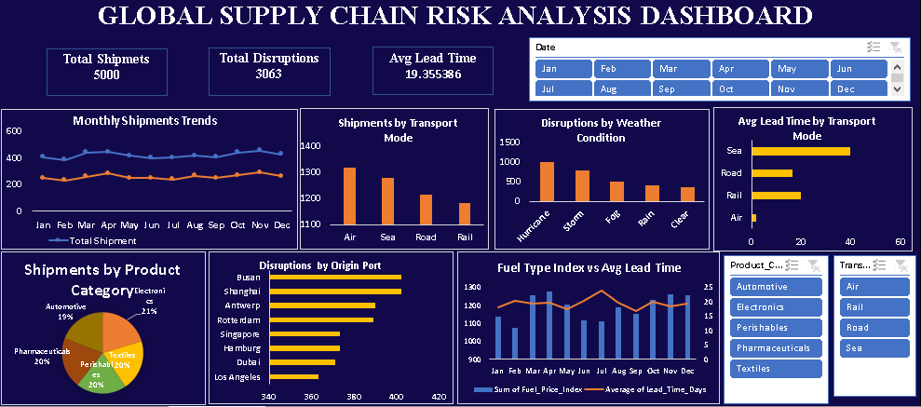
Excel Dashboard
KPI-driven spreadsheet reporting
Total Shipments: 5,000
Total Disruptions: 3,063
Average Lead Time: 19.355386 days
Monthly shipment/disruption trends
Transport mode, product, weather and origin-port views
Fuel Price Index vs Average Lead Time
Interactive filters are shown in the supplied view

Slide 11
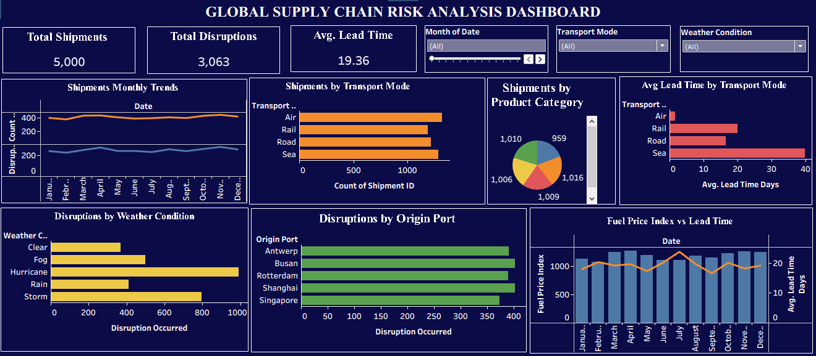
Tableau Dashboard
Interactive visual exploration
KPI cards for shipments, disruptions and lead time
Date/month and transport-mode filters
Monthly shipment trend
Transport-mode shipment comparison
Product category distribution
Weather and origin-port disruption analysis
Fuel Price Index vs Lead Time

Slide 12
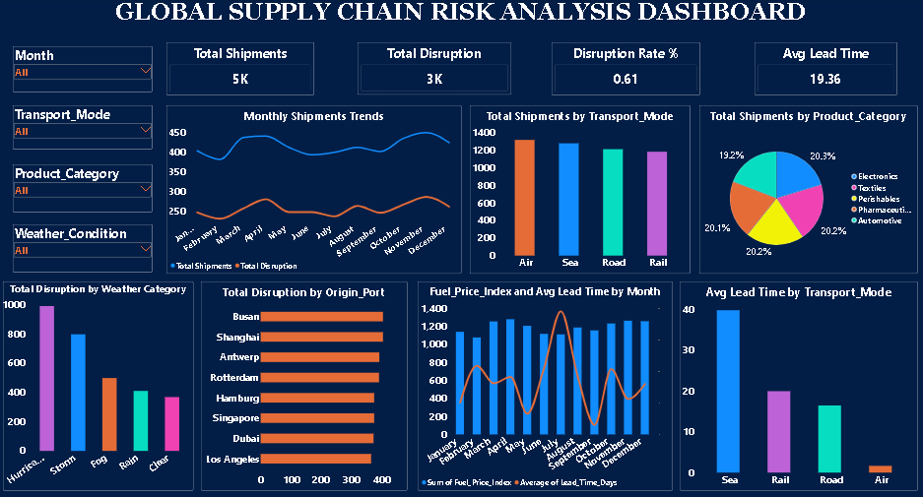
Power BI Dashboard
Interactive BI and KPI monitoring
KPIs: ~5K shipments, ~3K disruptions, 0.61 disruption indicator, 19.36-day average lead time
Slicers: Month, Transport Mode, Product Category, Weather Condition
Monthly shipment/disruption trend
Transport and product analysis
Weather and origin-port disruption views
Fuel Price Index + Average Lead Time by month

Slide 13
Tool-wise Comparison
EDA
Excel
Tableau
Power BI
Deep data exploration
Quick spreadsheet reporting
Interactive visual exploration
Business intelligence
Statistical analysis
KPI + charts
Filters + charts
KPIs + slicers
Python workflow
Pivot/filter workflow
Interactive dashboard
Interactive dashboard
Relationship analysis
Operational reporting
Visual comparison
KPI monitoring

Slide 14
Integrated Project Workflow
RAW DATA
5,000 shipment records
EDA
Clean • inspect • explore
EXCEL
Spreadsheet dashboard
TABLEAU
Interactive exploration
POWER BI
BI & KPI monitoring
INSIGHTS
Supply-chain reporting
Data → Analysis → Visualization → Business Reporting

Slide 15
Key Dashboard Observations
Scale
Scale
5,000 shipments are covered across the project.
Disruption
Disruption
3,063 disruptions are displayed in the supplied dashboard views.
Lead Time
Lead Time
Average lead time is approximately 19.36 days.
Transport
Transport
Air, Rail, Road and Sea are compared by volume and lead time.
Risk Factors
Risk Factors
Weather, geopolitical risk, fuel price and distance are included.
Monitoring
Monitoring
Monthly trends support time-based shipment and disruption monitoring.

Slide 16
Limitations & Interpretation Notes
Dashboard screenshots do not expose every underlying formula, calculated field or filter configuration.
The disruption-rate definition should be documented explicitly; the EDA binary field mean is 0.6126 while dashboards may show 0.61.
Mean lead time should be interpreted alongside the median because lead-time observations vary substantially.
Correlation or visual association should not be treated as proof of causation.
Dashboard values are sometimes rounded (for example, 5K and 3K).
The supplied project package did not include a separate raw CSV/ZIP file; EDA findings are based on the notebook outputs.

Slide 17
Future Scope
Add drill-through pages for origin port, destination port, transport mode and product category.
Add conditional formatting for high lead-time and high-risk shipments.
Build a dedicated risk segmentation view combining geopolitical risk, carrier reliability, weather and disruption.
Add monthly/year-over-year comparisons when additional years become available.
Add anomaly detection for unusually high lead-time shipments.
Consider predictive modeling after defining a target and validating data quality.
Document dashboard measures and formulas for reproducibility.

Slide 18
CONCLUSION
The project demonstrates an end-to-end analytics workflow—from Python EDA to Excel,
Tableau and Power BI dashboards.
Together, the views cover shipment volume, disruptions, transport modes, products, weather, ports,
carrier reliability, fuel price, geopolitical risk and lead time.
This creates a consistent framework for descriptive analysis and visual reporting.

Slide 19
THANK YOU
Global Supply Chain Risk Analysis
EDA • Excel • Tableau • Power BI

